Slide 1
How (and why) to use GitHub for your research
Learn Bioinformatics Chat
April 2022
Slides will be available on our intranet site!
https://learn-bioinformatics.lan.omrf.org/

Slide 2


Slide 3
This is a big problem for usability and reproducibility.
“ RNA-seq data analysis
Raw sequencing reads were curated as previously described (25). Briefly, the FASTQ files were subjected to adapter trimming to remove the low-quality reads and short reads. All clean data were mapped to the human genome GRCh38 using HISAT2 v2.1.0 with default parameters. Bam files were sorted by Samtools 1.9. Gene counts were summarized using the feature Counts program as part of the Subread package release 2.0.0
“
There is no code associated with this paper.

Slide 4
Usability
Reproducibility
Can your own lab currently use and build upon the code if the code writer leaves?
Can your lab reproduce the analysis and rebuild all figures from raw data if the code writer leaves?
Local
Can anyone download, use, and build upon your code?
Can anyone find your raw data and code, and reproduce your analysis and figures?
Global
All four problems can be solved by using GitHub.

Slide 5


What is GitHub?

Slide 6
Git is a version control software that lets you save checkpoints of your work. Git runs locally. GitHub is an online home for your Git projects.

Slide 7
Core Features of using Git + GitHub
Version
Control
Code
Organization
Collaboration
Reproducibility

Slide 8
Features of Git + GitHub
Version
Control
Maintains old versions of code – shows you specifically what changed between each version.
Collaboration
GitHub makes it easy for lab members to work together, or for external collaborators to work with you. Can control private or public access with ease.
Code
Organization
Each change is documented so you don’t need to save duplicate versions of files over and over. Publishing code causes you to think about how your code is presented and encourages you to write documentation.
Reproducibility
Your repositories can be easily shared and enable your research code to be reproducible, for future use in your own lab, or for other people across the world using your research.

Slide 9
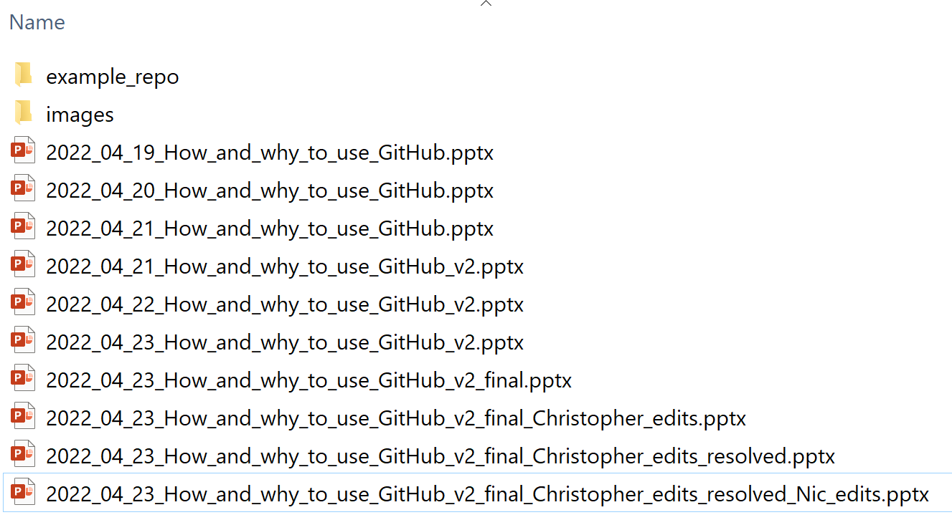
Do your files look like this?
If so, you need git (version control).

Slide 10
One caveat, GitHub is not a place to store large datasets
It is not meant to be used for storing large datasets. GitHub is for code and analysis scripts or small files.
For local, secure data storage, use the OMRF Data Server, Dropbox, or the o3 Archive (contact Stuart Glenn for help moving data to o3).
For sharing datasets for publication, you will need to upload and store within one of the public repositories, such as the Sequence Read Archive (SRA), the Gene Expression Omnibus (GEO), the Imaging Data Commons, etc. See a list of all the NIH-affiliated Data Repositories here:
https://sharing.nih.gov/data-management-and-sharing-policy/sharing-scientific-data/repositories-for-sharing-scientific-data

Slide 11
Why use GitHub?

Slide 12
The biggest reason to use GitHub for research? Your code is easy to share for publication. This increases your research impact and citations.

Slide 13
The second biggest reason to use GitHub for research? The NIH is updating their data sharing guidelines on Jan 25 2023, and you need to specify how you plan on sharing your data and your analysis / code. Using GitHub increase the likelihood of getting NIH-funding.

Slide 14
How to use GitHub?

Slide 15
You will need:
1
GitHub Account
2
Some Code or Text
3
A Repository created on the GitHub website
4
(Windows) Git for Windows – Mac and Linux have preinstalled Git

Slide 16
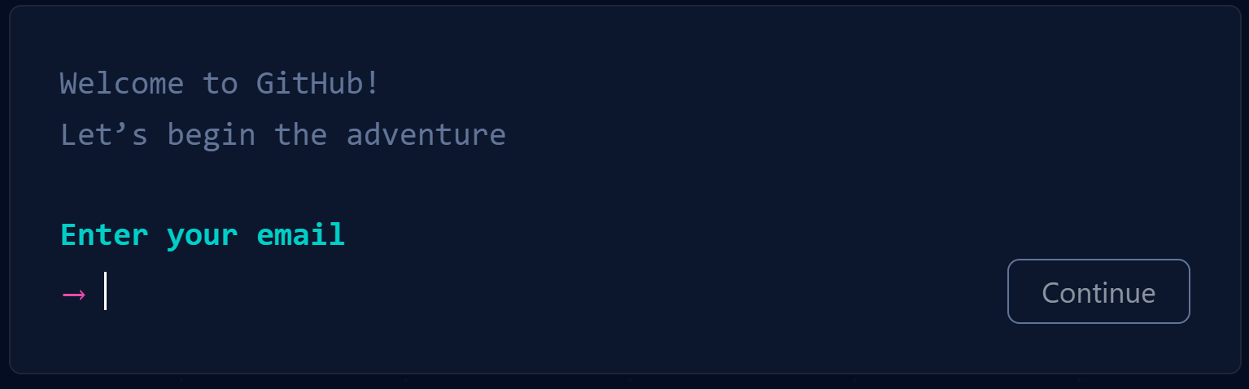
1
GitHub Account
Simply go to: github.com
and click Sign Up

Slide 17
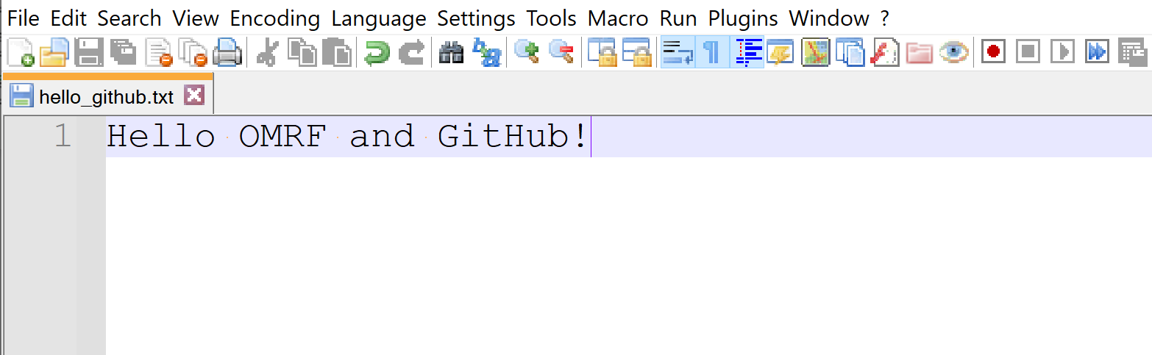
2
Some Code or Text
Can upload any file:
< 100Mb if uploading from the command line, or
< 25Mb if uploading on the web interface.
Total Repository size limits:
< 1Gb Recommended
< 5Gb Strongly Recommended
Example file we want to version control on GitHub:

Slide 18
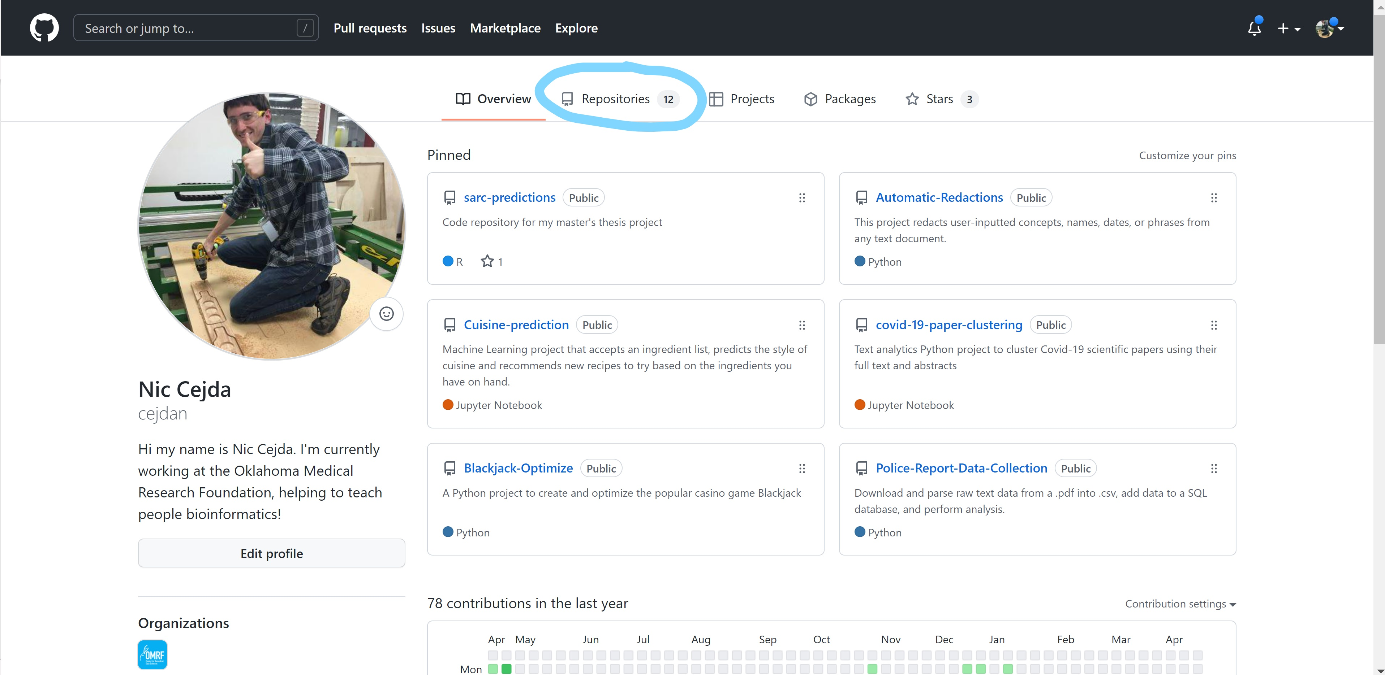
3
A Repository created on the GitHub website

Slide 19
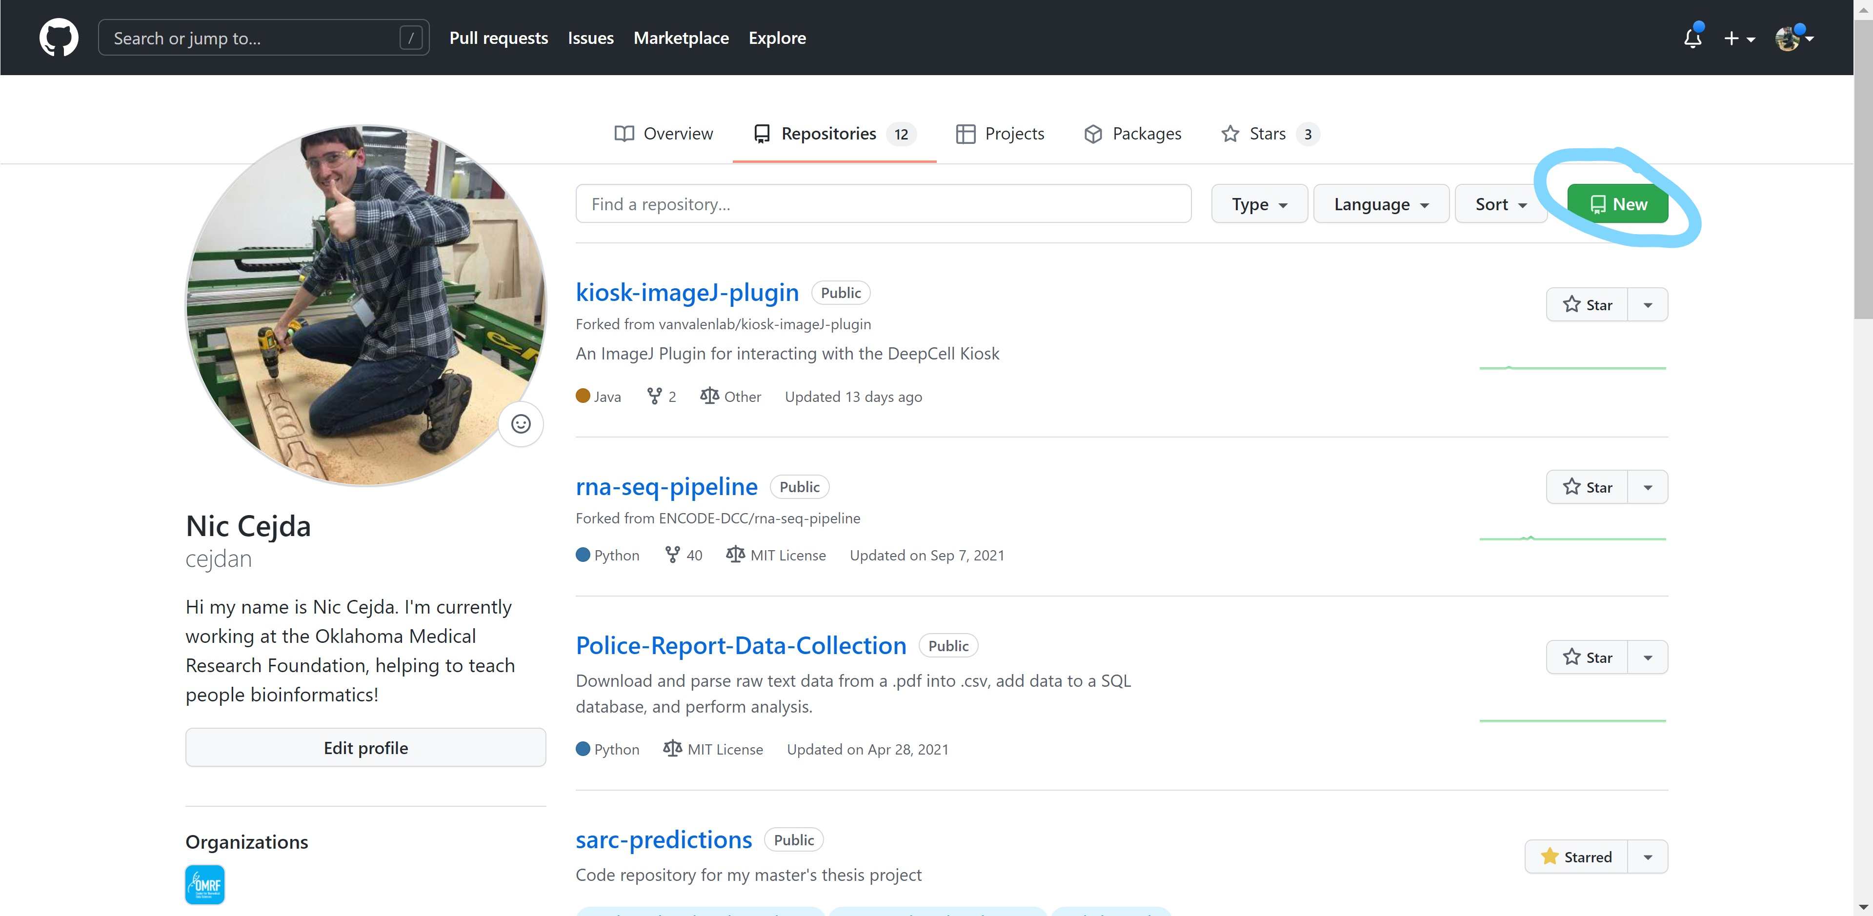
3
A Repository created on the GitHub website

Slide 20
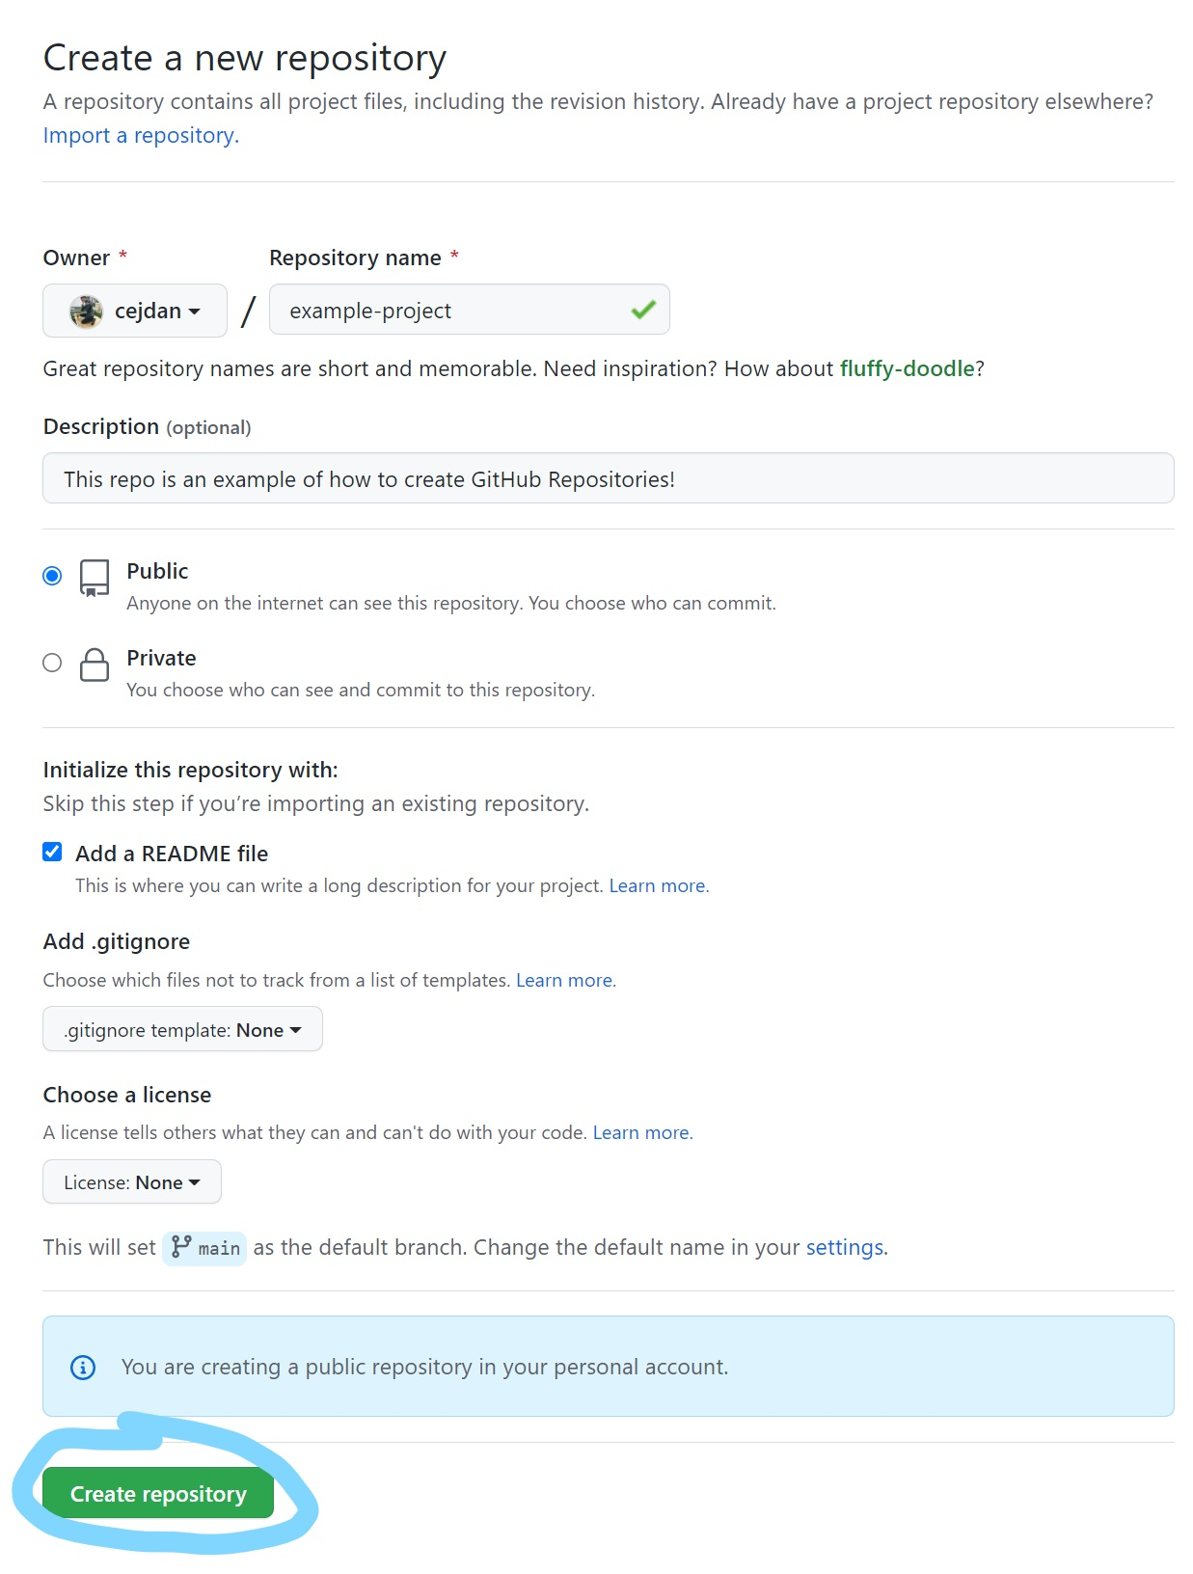
3
A Repository created on the GitHub website
Can choose Public or Private depending on need

Slide 21
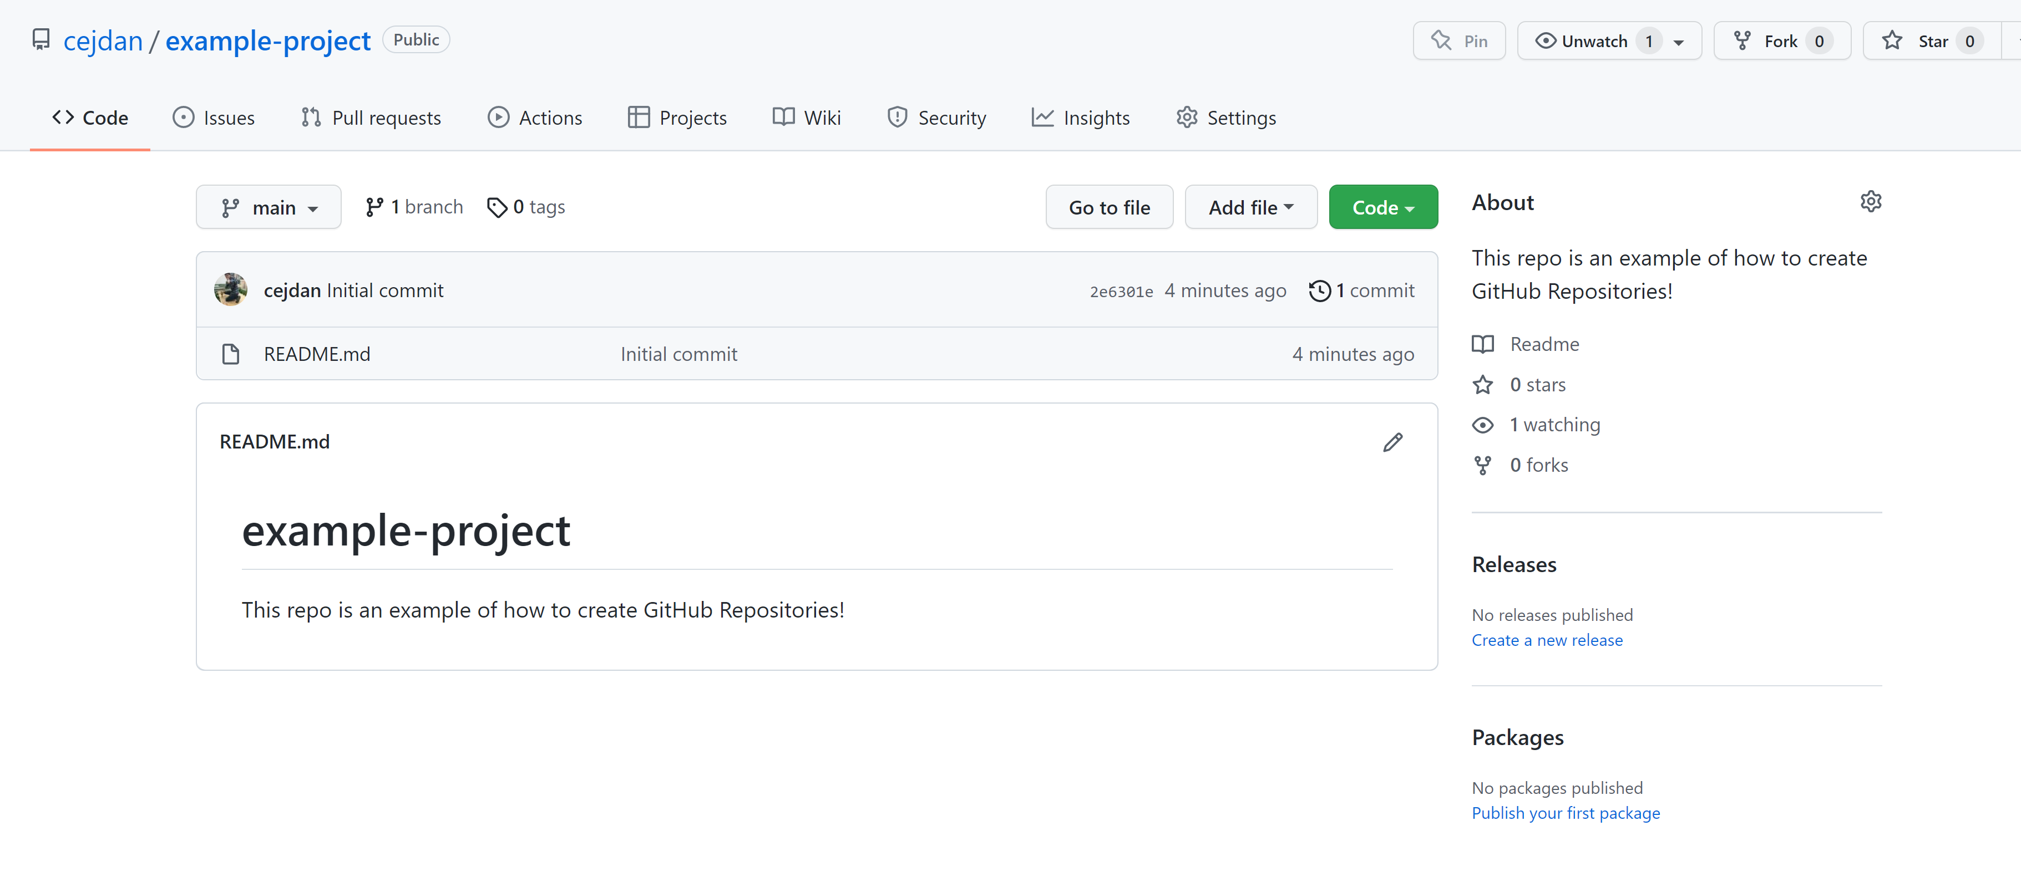
3
A Repository created on the GitHub website

Slide 22
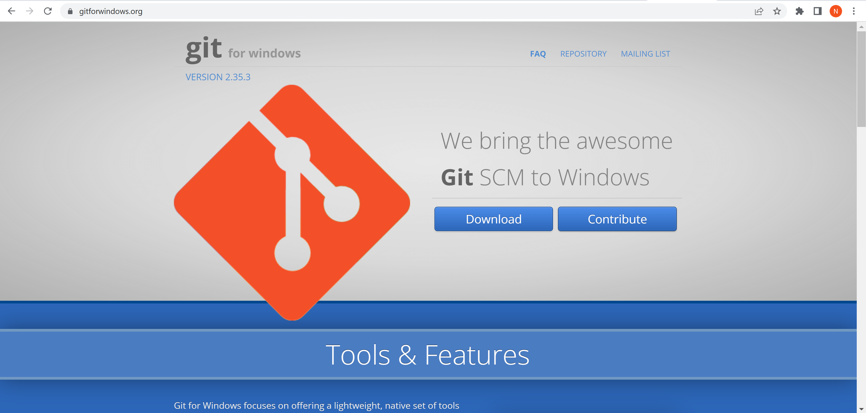
4
(Windows) Git for Windows – Mac and Linux have preinstalled Git
Windows users, navigate to https://gitforwindows.org/
Download and follow the default install instructions.
Git comes pre-installed on Mac and on our Linux compute cluster!

Slide 23
How to use Git! First, we need to get set-up.
Command | Description
git config –-global user.name “your_github_username” | Sets up your username so GitHub will recognize you.
git config –-global user.email “your_github_email@example.com” | Sets up your email so GitHub will recognize you.
git config –-global --list | Shows your current config setup information.

Slide 24
How to use Git! The essential commands.
Command | Description
git clone https://... | Clones an existing repository from the web onto your local machine.
git add filename(s) | Adds a file to your git stage, won’t commit yet!
git status | Shows all the files that have been changed and displays which files have been added to the stage.
git restore –-staged filename(s) | Removes a file from the stage.
git rm filenames(s) | Removes a previously committed file from the repository. Won’t commit the deletion yet!
git commit –m “description” | Creates a version control checkpoint. This is the most important operation! Does not push changes to the web yet, only commits locally.
git push | Pushes committed changes to the web. This might involve merging if your local version and the web version modified the same file.
git pull | Updates your repository with the latest commit from the web. Might involve merging if the web version and local version modified the same file.

Slide 25
How to use Git! A few more advanced commands.
Command | Description
git checkout –b branchname | Create and switch to a new branch.
git checkout main

Slide 26
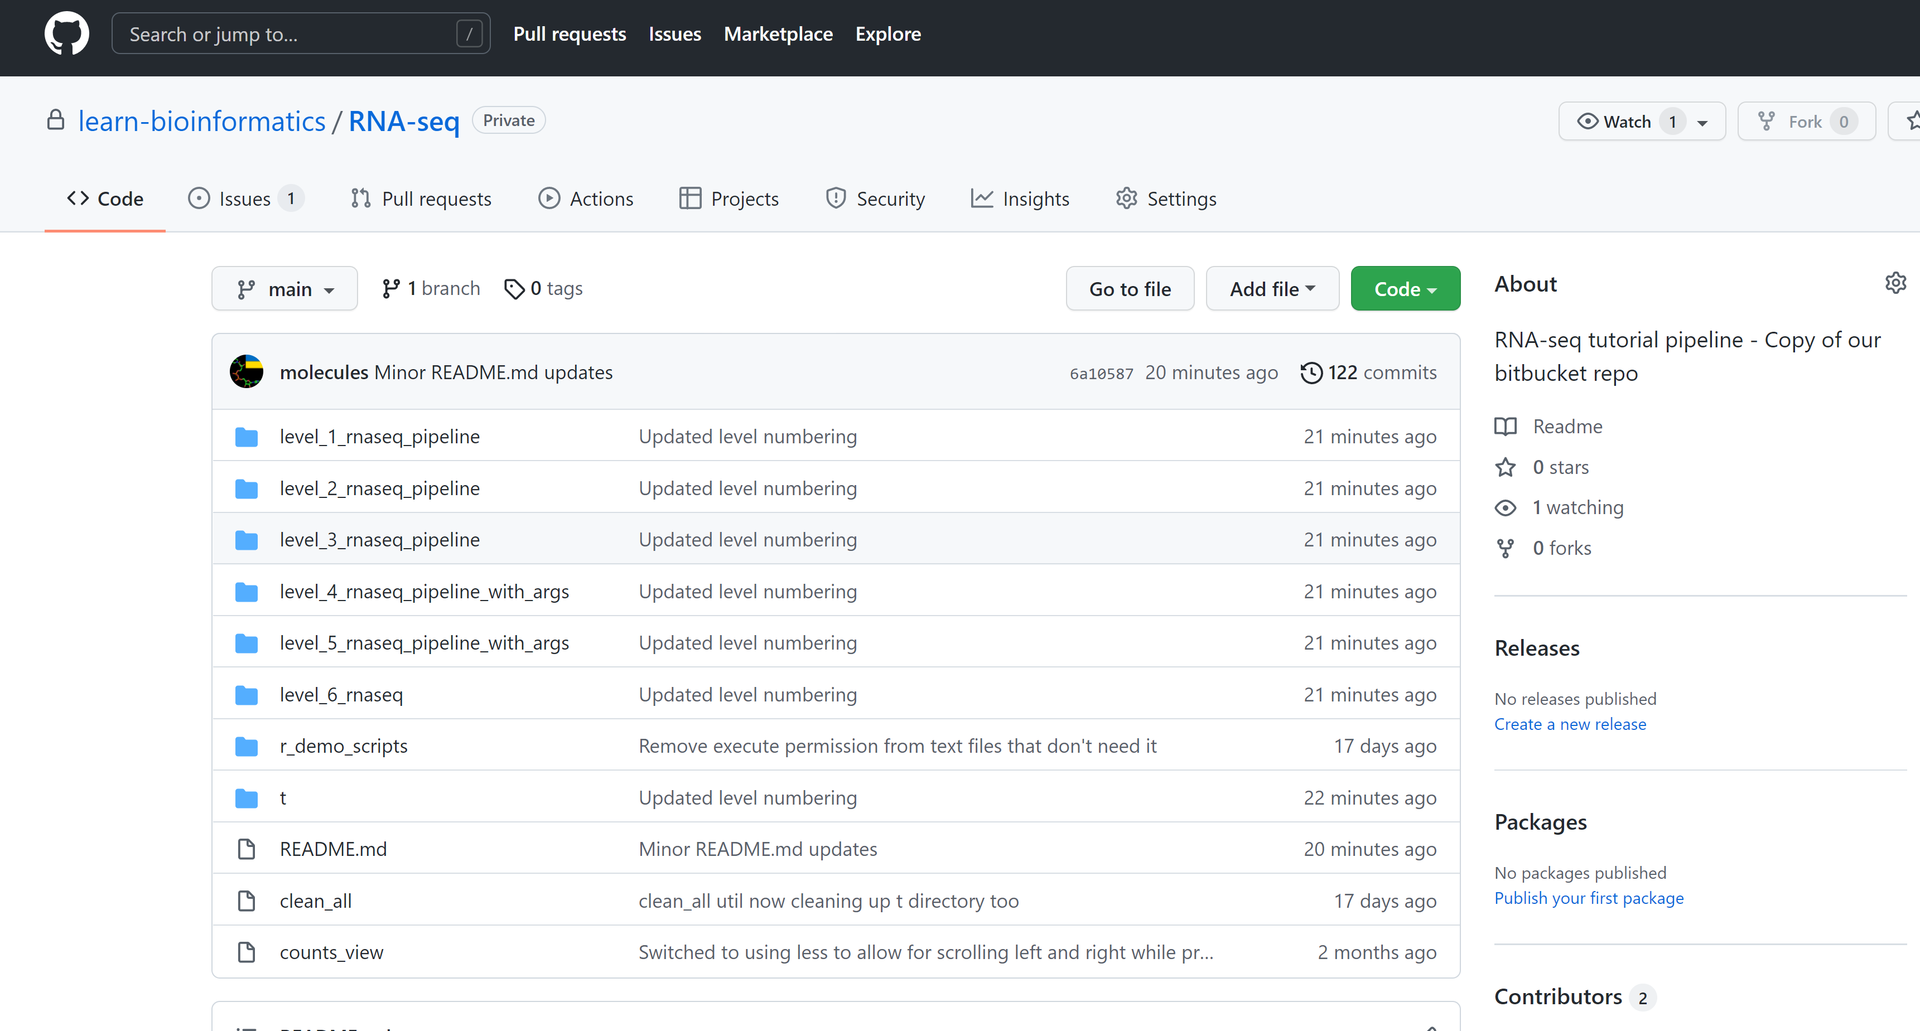

Slide 27
Using Git
A few notes:
Git runs locally on your machine.
GitHub is a cloud-based Git hosting site.

Slide 29


